Slide 1
Categorical Association

Slide 2
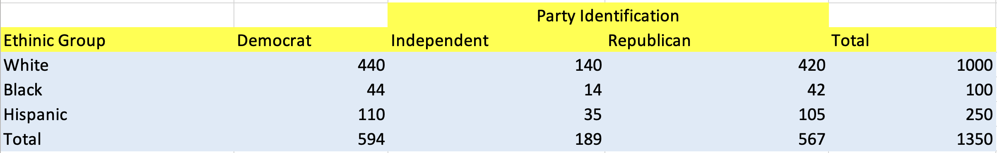
Categorical Association

Slide 3
Categorical Association
Given the ethnicity, what is the party affiliation?

Slide 4
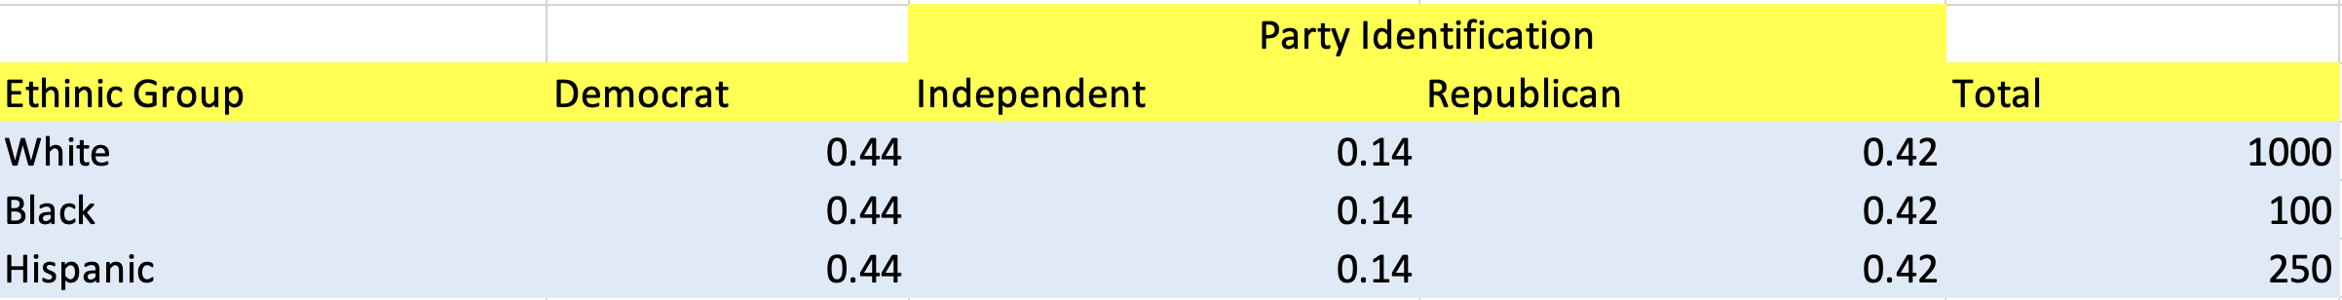
Categorical Association
Given the ethnicity, what is the party affiliation?

Slide 5
Categorical Association
Given the ethnicity, what is the party affiliation?

Slide 6
Categorical Association
Given the ethnicity, what is the party affiliation?

Slide 7
Categorical Association
Given the ethnicity, what is the party affiliation?

Slide 8
Categorical Association
Given the ethnicity, what is the party affiliation?
The proportion of Democrats, Independents and Republicans doesn’t change.

Slide 9
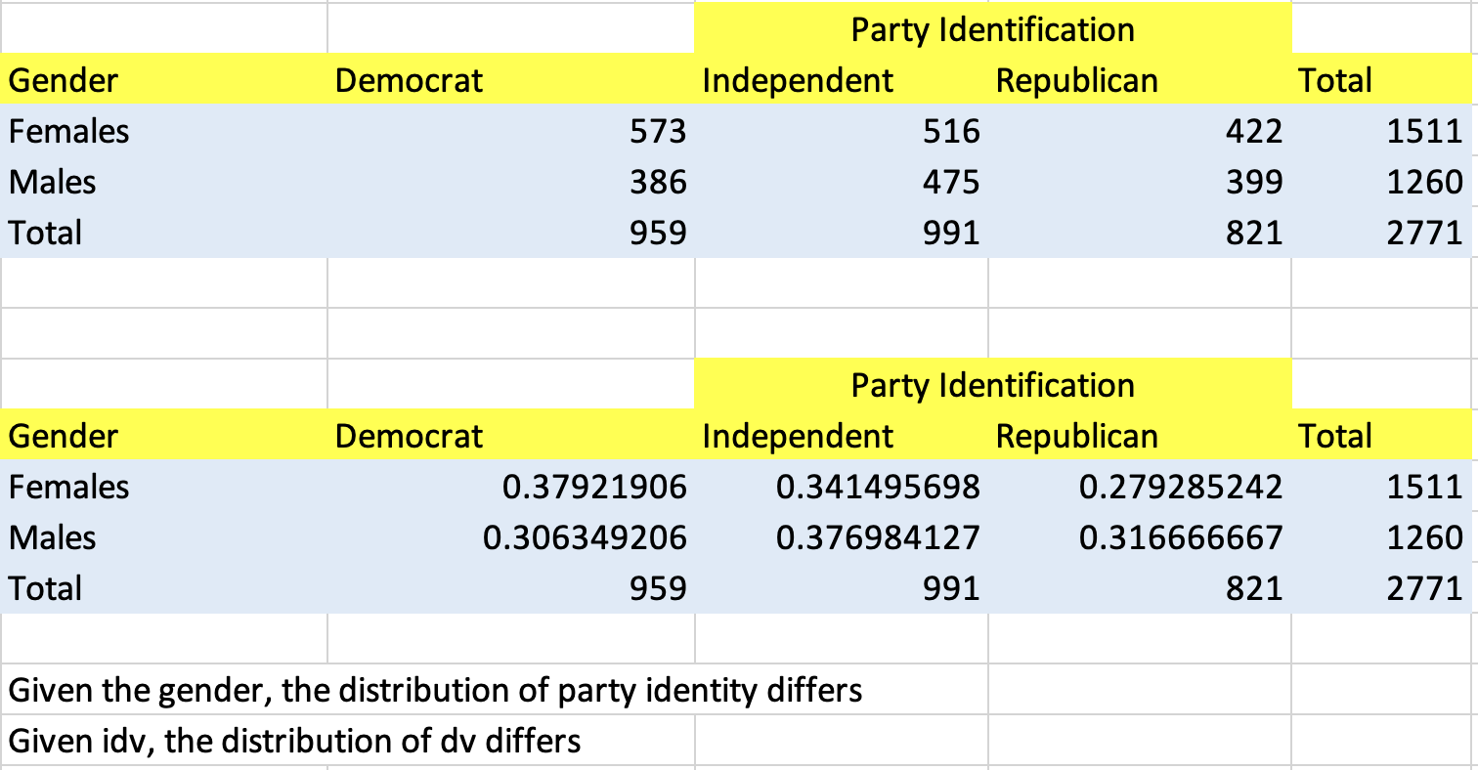
Categorical Association

Slide 10
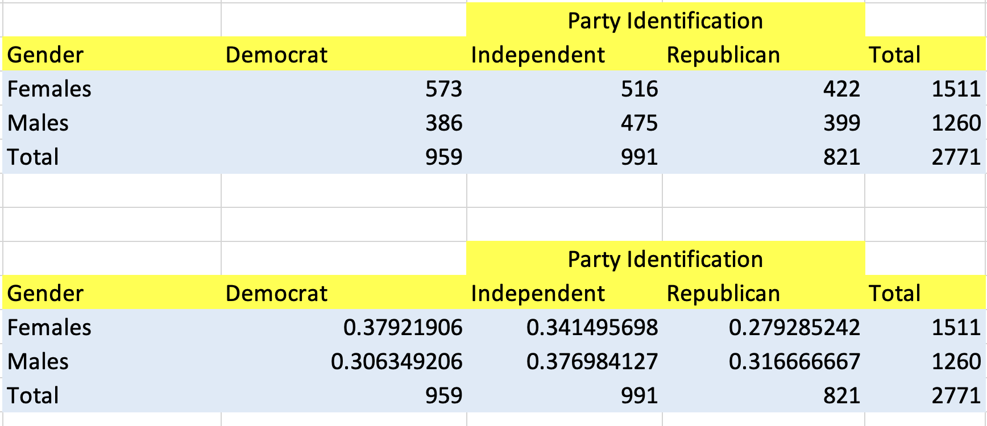
Chi Square Test of Factor Association
Are Women more likely to vote for democrats
And men for republicans? From this sample both Gender and Party Affiliation seem to be related

Slide 11
Chi Square Test of Factor Association
Are Women more likely to vote for democrats
And men for republicans? From this sample both Gender and Party Affiliation seem to be related
Is it true only for this sample or can this be generalized?

Slide 12
Chi Square Test of Factor Association
We can do a hypothesis test in this situation.
Are Women more likely to vote for democrats
And men for republicans? From this sample both Gender and Party Affiliation seem to be related
Is it true only for this sample or can this be generalized?

